Slide 1
Finance Calculator
Honghao, Ayush, Qiyu

Slide 2
Inspiration
Inheritance of HW3
Construction of a Calculator that not only supports the integer-based arithmetic but also floating-point-based accuracy
Support for differentials and integrals
Simulation of the Texas Instruments’ BA II Plus Calculator
Compute the Value of a given kind of Currency
Evaluate the Cash Flow
Regression Analysis of Series Data: mean and variance

Slide 3
Design
The Problem to Solve
Interpretation of Arithmetic Expressions
Evaluation of the Result out of the Expressions
Data Structures and Algorithms
Stack
Any Sorting Algorithm to help with RPN

Slide 4
Basic Features
Entry of the Expression
Support with Entries that contains Spaces
Interpretation for the Expression
Distribute the Data by the Priority of operation
Calculate the Results

Slide 5
Test Case
(9 * (7 + (3 * (6 – 4)))) / (5 – (1 + 8))
(9 + 2) * ((4 – 2) * (5 + 3) + 1) – (7 – 5) * ((6 + 3) * (2 – 1) + 4)
(1 + (2 * (3 – 4))) * (5 / (6 + 7))
((1 + 2) * (3 – 4)) / ((5 + 6) * (7 – 8))
(1 + 2) * (3 * 4 – 5)
(2.4 * (4 * (34 – 6/2.5) – 5)) - 8

Slide 6
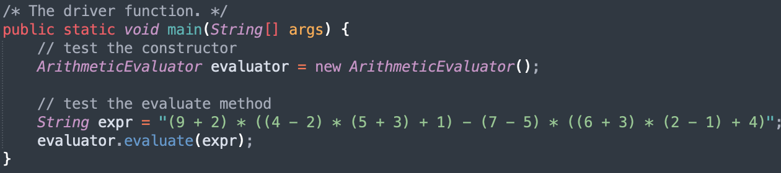
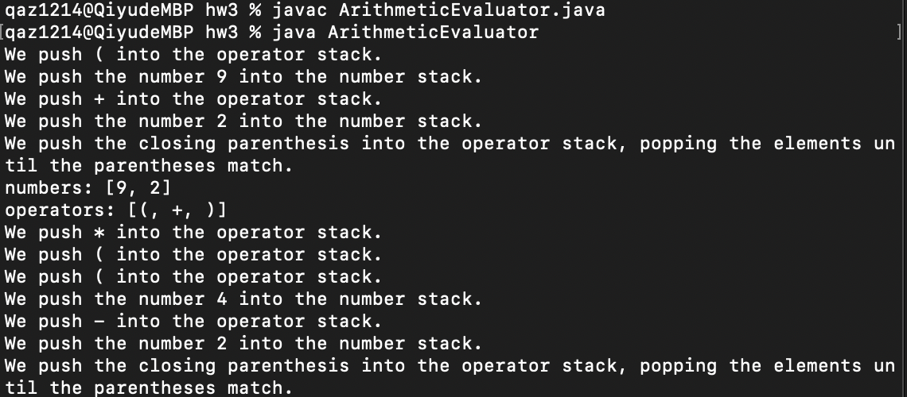
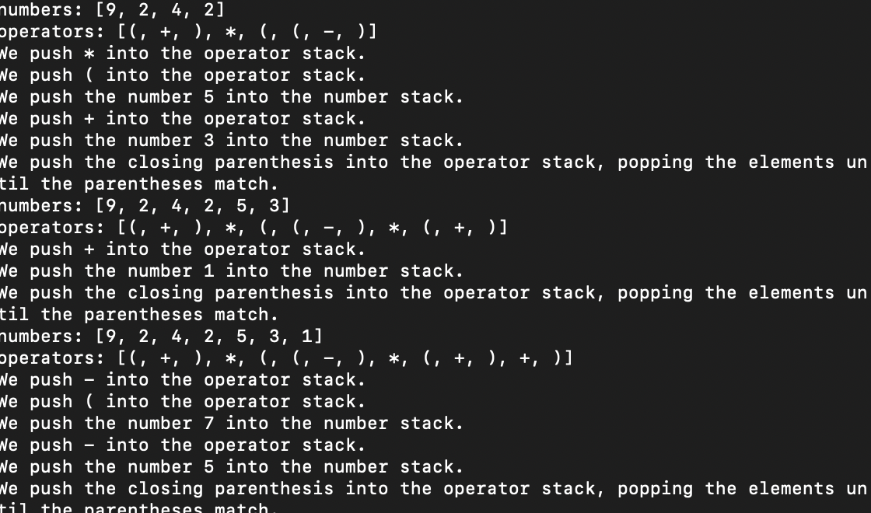
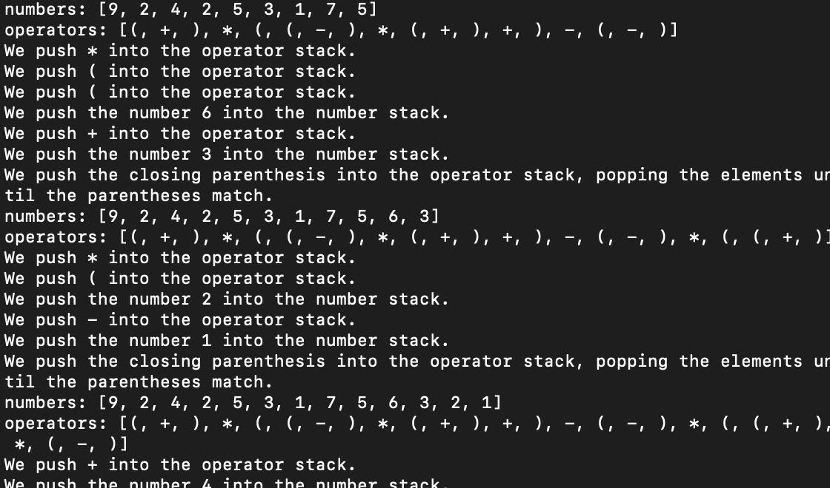
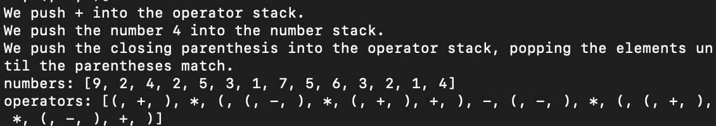
Test Case (Cont’d)

Slide 7
Full Code
https://github.com/ZhongQiyu/sp23-cs608-midterm

Slide 8
TODO
Entry of the Expression
Support with Entries that contains Spaces
Interpretation for the Expression
Reverse Polish Notation
Currently only applies two separate Stacks
To apply just one Stack at the time of operation
Test upon the Validity
No extra Spaces

Slide 9
Reference
API of CS608 HW3’s Calculator
W3Schools Online Web Tutorials
Mathematica (https://reference.wolfram.com/language/tutorial/AlgebraicCalculations.html.zh?source=footer)
User Manual of BA II Plus

